Slide 2
Md. Billal Miah
Head Teacher
Bhairab Model Govt. Primary School
Bhairab, Kishoregonj.
: 01715-410013
: 029470575
: billalnayeem@gmail.com

Slide 3
Class: Five
Subject: English
Lesson: 21 (Life Is Beautiful!)
Lesson Unit: A, A1
Time: 45 minutes
Date: 18/01/2013

Slide 4
Learning Outcomes
Students will be able -
to know and use meaning and spelling of the new words.
to read the text with correct pronunciation.
to make sentences using words and structures given in the textbook.

Slide 5
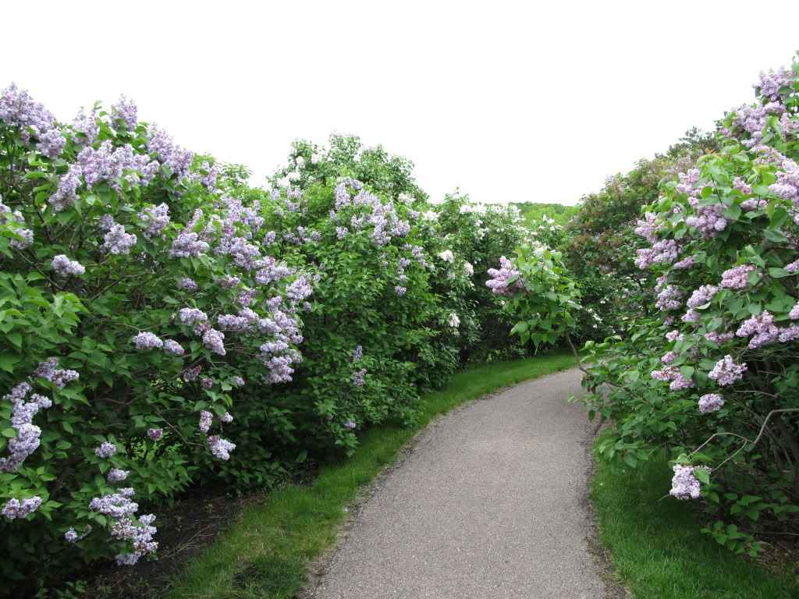
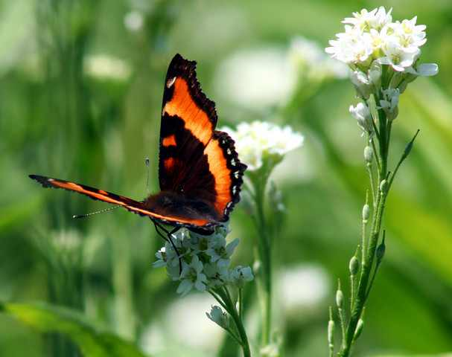
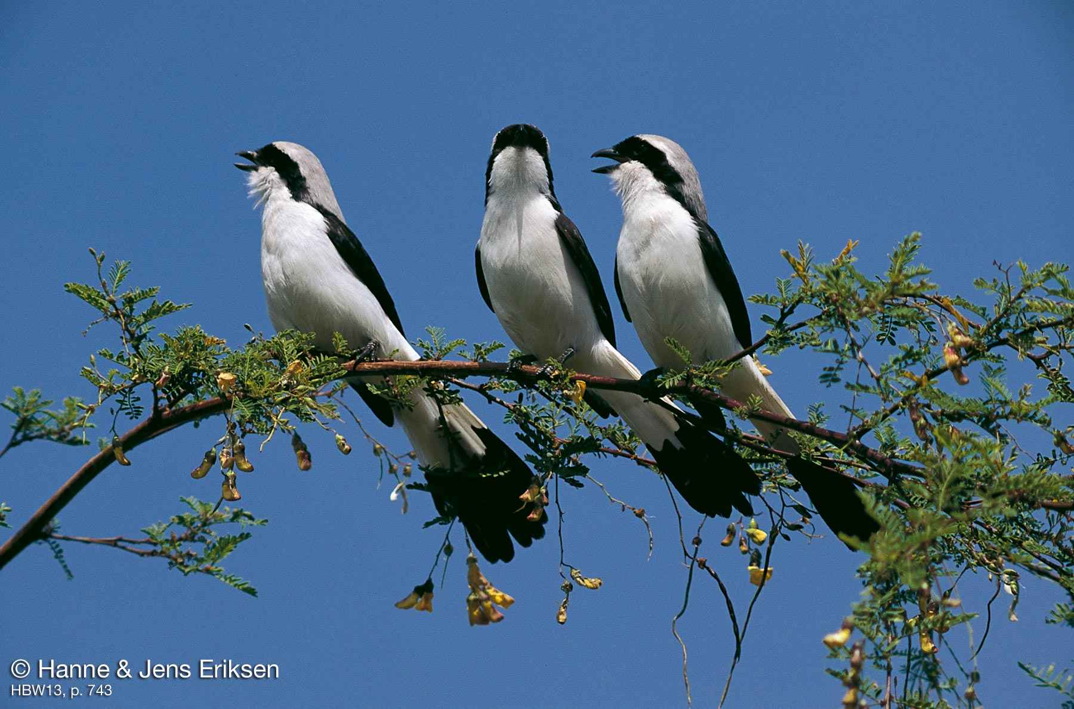
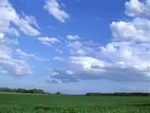

Slide 6
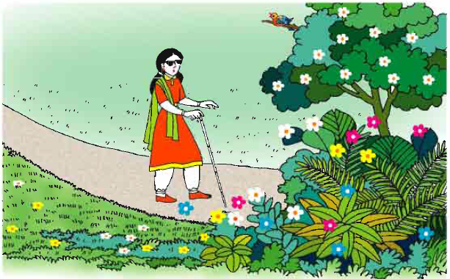
Life Is Beautiful!

Slide 7
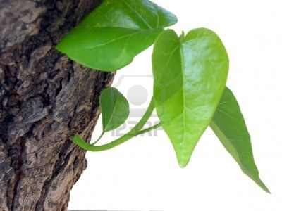
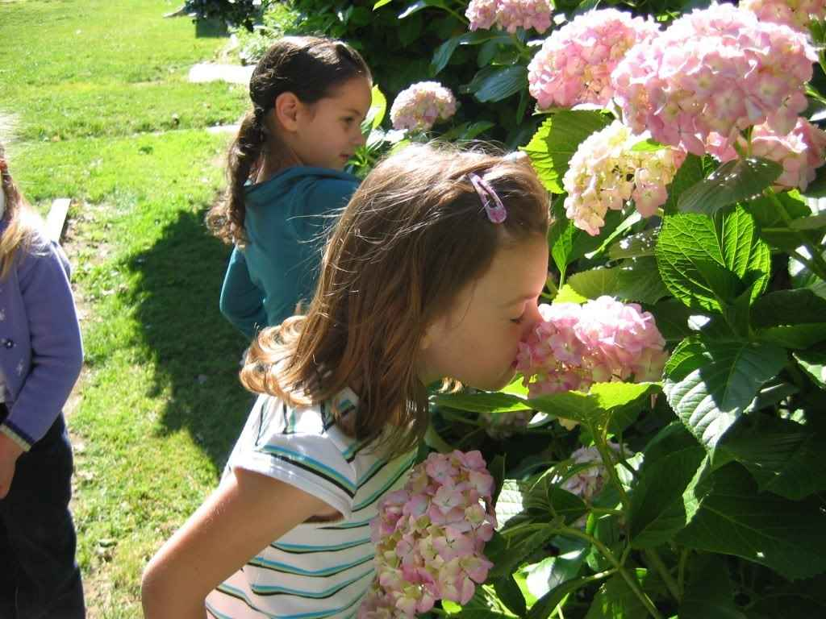
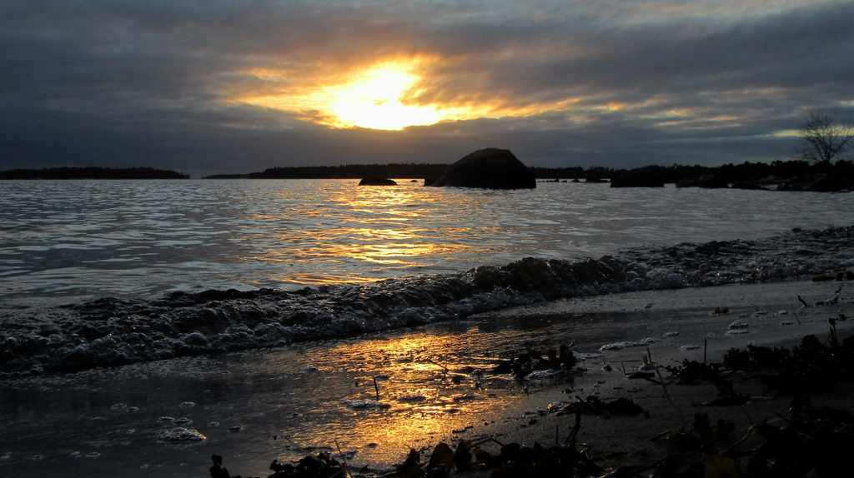
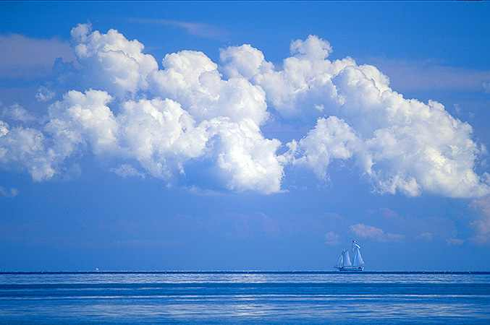
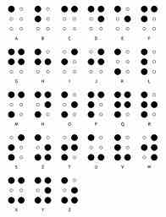
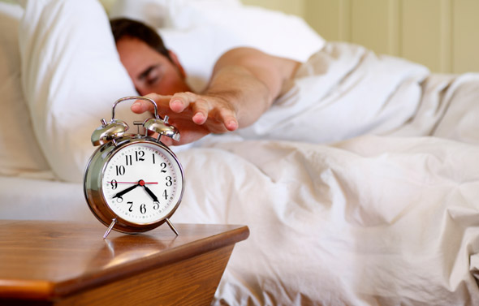
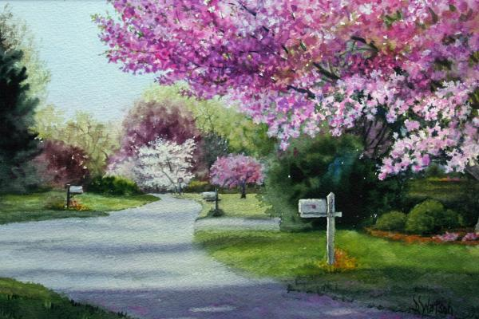
New Words
Spring
Smell
Flowers
Blue sky
Braille
Colours
Raised dots
Wake up
Impaired
Warmth
Green leaves

Slide 8
Kim`s Game
Warmth
Colours
Spring
Impaired
Braille
Raised dot

Slide 9
It`s a beautiful spring day.

Slide 10
Maria wakes up early feeling happy. She knows that it is a nice day because she can smell the flowers.

Slide 11
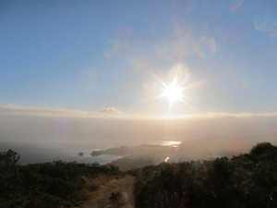
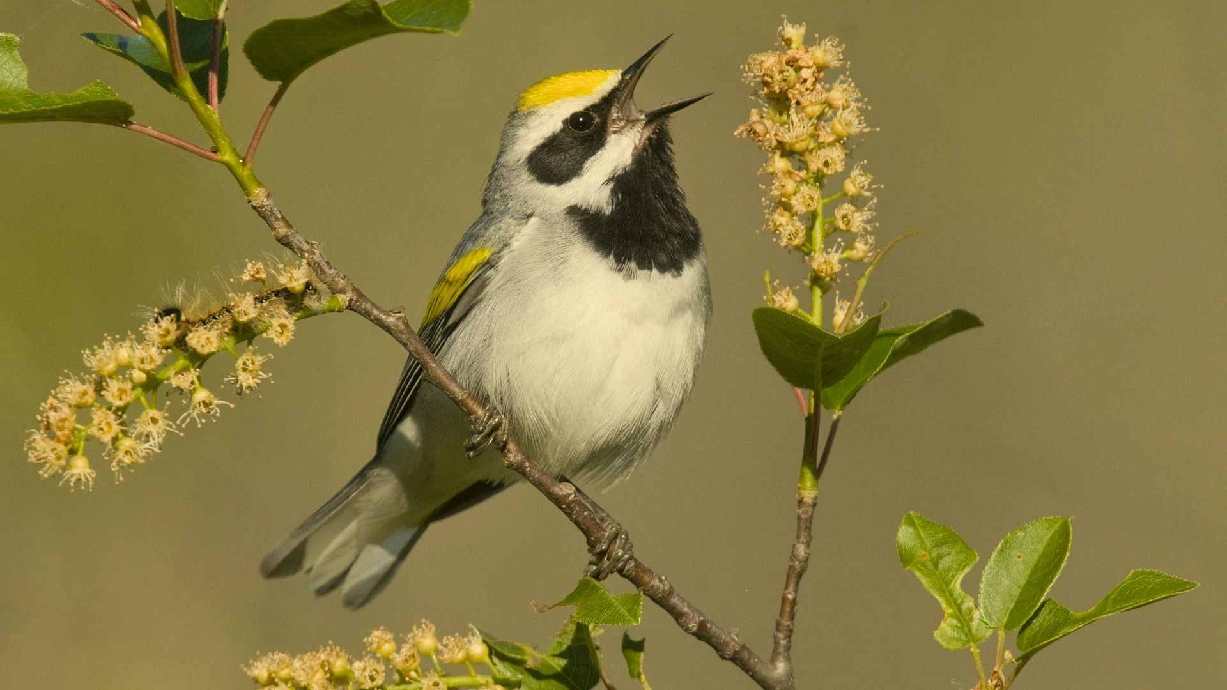
She can feel the soft warmth of the sun and can hear the birds singing.

Slide 12
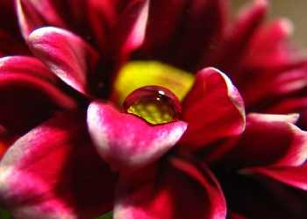
Maria cannot see the spring day. She can`t see lovely flowers ,or the blue sky.

Slide 13
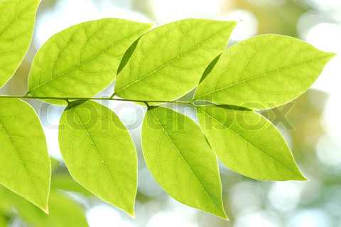
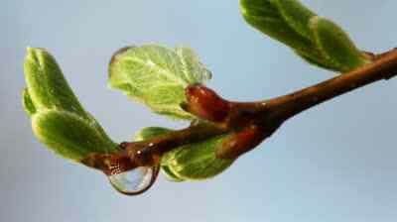
She can`t see the new green leaves on the trees.

Slide 14
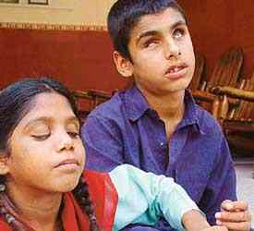
She cannot see the colours because she is visually impaired. She has been visually impaired since birth.

Slide 15
But Maria is happy. She goes to a school where she is learning to read using Braille. Braille is a kind of script in which the words are written in raised dots.

Slide 16
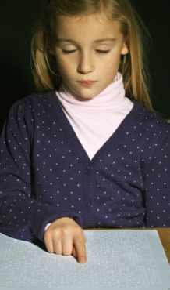
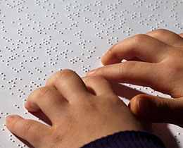
Maria is learning to read by touching the raised dots with her fingers. She loves to go to school. Maria`s teacher says that she is a quick learner.

Slide 17
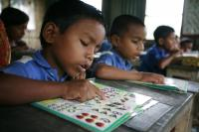
Student`s Loud Reading

Slide 18
Student`s Silent Reading

Slide 19
Discuss the following questions in pairs
How does Maria know that it is a nice day?
Ans: Because she can smell the flowers.
☞ Why can`t Maria see?
Ans: Because she is visually impaired.
☞ How is Maria learning to read?
Ans: Maria is learning to read by touching the raised dots with her fingers.

Slide 20
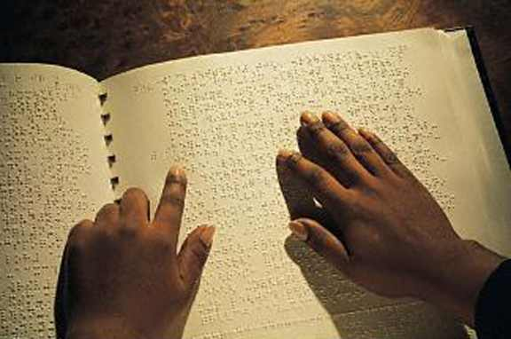
Choose the best Answer:
(Chain drill) SGW
Maria cannot see because-
a) She was born blind.
b) She fell ill and lost her eyesight.
c) It is dark in the night.
√
❒ Maria wakes up on a-
a) hot day
b) warm day
c) rainy day
❒ Maia can read-
a) with her fingers.
b) with the help of her friends.
c) when she is happy.

Slide 21
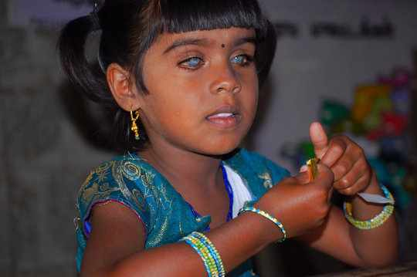
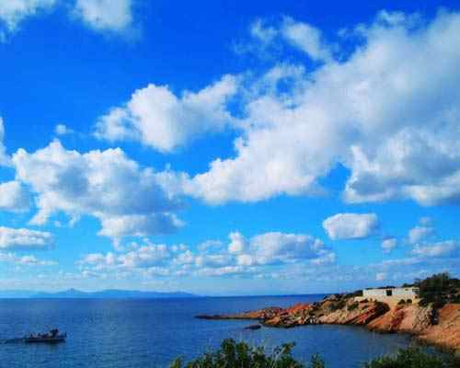
Write five sentence about Maria
(IW)
Maria

